Slide 1


REDDIT
CLIENT
By: Group 2

Slide 2

MEMBERS
Lê Việt Ân
22BI13009
Bùi Minh Đức
22BI13085
Phạm Ngọc Phương Anh
22BI13037
Nguyễn Đức Dũng
22BI13106
Phạm Chí Bách
22BI13055
Trần Mạnh Duy
22BI13126
1

Slide 3
TABLE OF CONTENTS
1
2
3
4
5
Introduction
Architecture
Activities
Demo
Conclusion
2

Slide 4
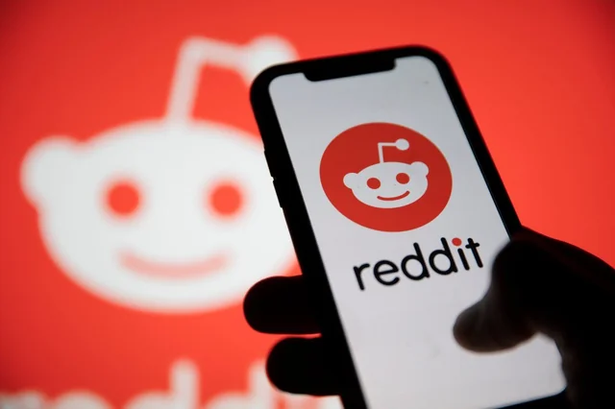

INTRODUCTION
Introduction
Reddit - a media platform
allows users to share content, participate in dicussions, engage in diverse communities
community - “subreddit” - focused on specific interests
users can post content while others upvote and downvote, influencing the visibility of the content
a vast range of topics
Architecture
Activities
Demo
Conclusion
3

Slide 5
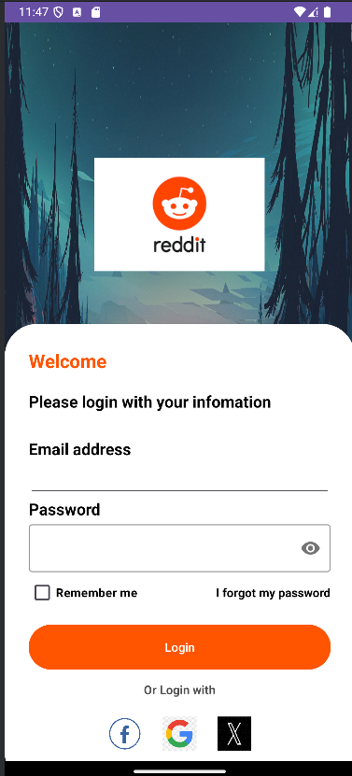
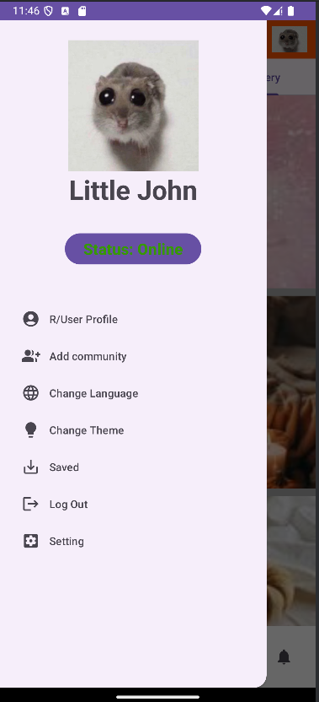
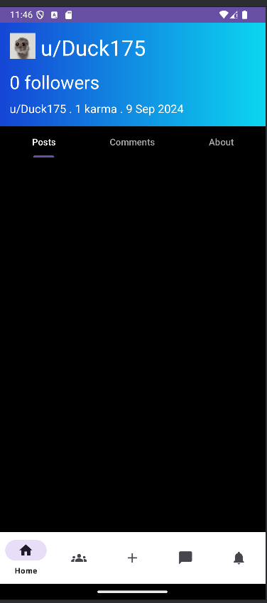
ARCHITECTURE
Architecture
Activities
Demo
Conclusion
4

Slide 6
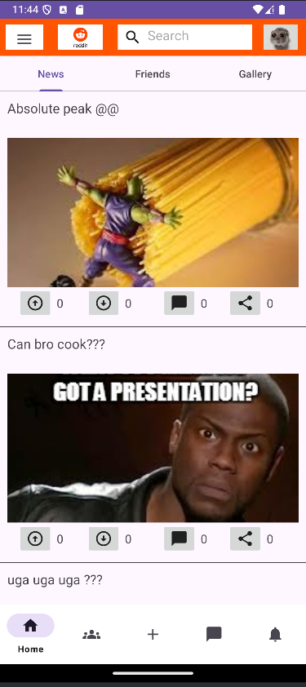
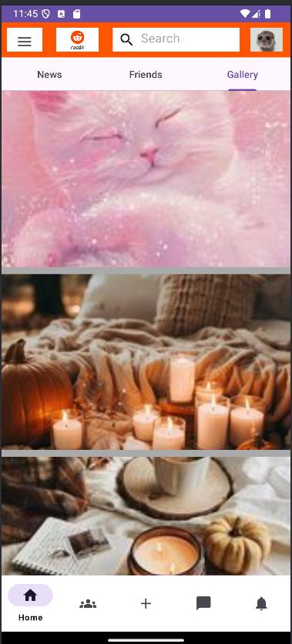
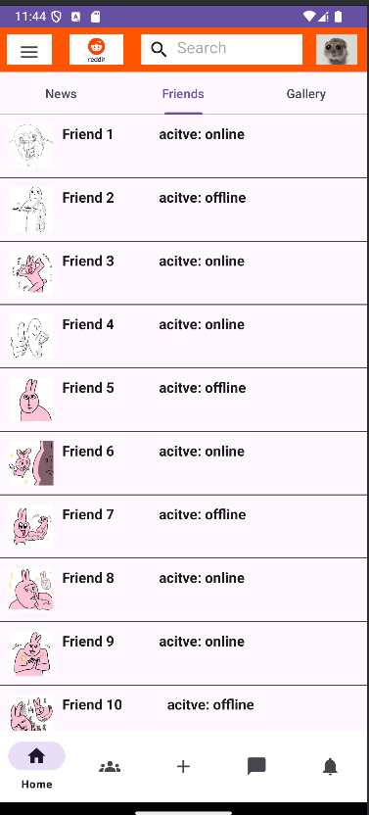
ARCHITECTURE
Architecture
Activities
Demo
Conclusion
5

Slide 7
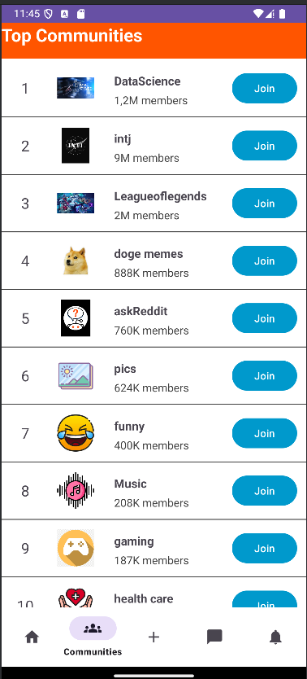
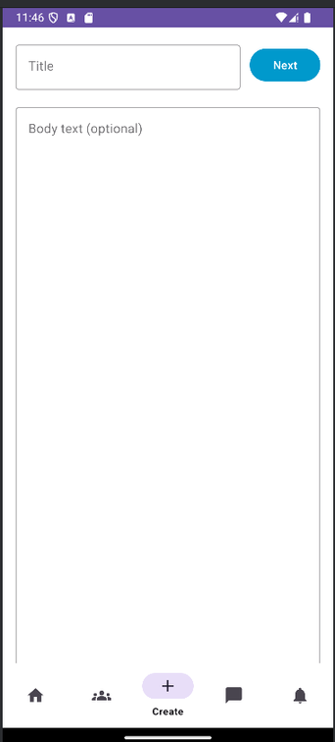
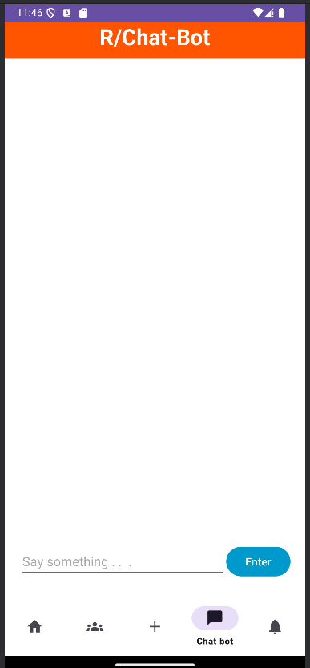
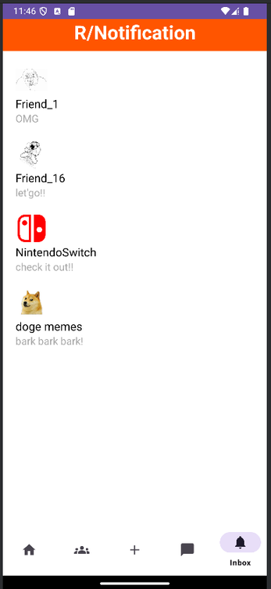
ARCHITECTURE
Architecture
Activities
Demo
Conclusion
6

Slide 8
ACTIVITIES
Fill in the information
Tick “Remember me” to remember login information
Login
Link to Facebook/Google/X account
Activities
Demo
Conclusion
7

Slide 9
ACTIVITIES
Activities
Click into the “User profile”
See your User profile
Demo
Conclusion
7

Slide 10
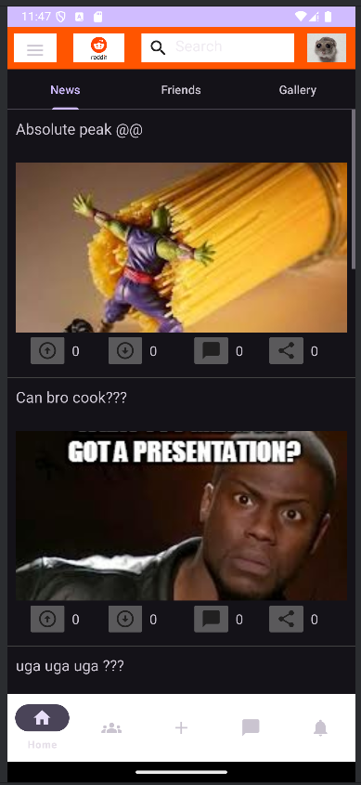
ACTIVITIES
Activities
Click into the “Change Theme” to change the theme from light mode to dark mode
Demo
Conclusion
7

Slide 11
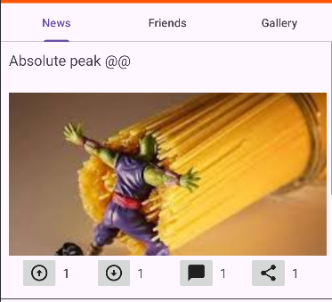
ACTIVITIES
Each post can upvote, downvote , comment, share link
Activities
Demo
Conclusion
7

Slide 12
ACTIVITIES
Change to friend list, news and gallery layout by clicking News, Friends and Gallery.
Scroll down to see more informations.
Activities
Demo
Conclusion
7

Slide 13
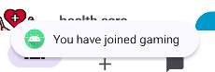
ACTIVITIES
Scroll down to find the community to join
Click into “Join” button to join that community
Activities
Demo
Conclusion
7

Slide 14
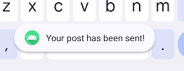
ACTIVITIES
Add title and content
Up your post.
Activities
Demo
Conclusion
7

Slide 15
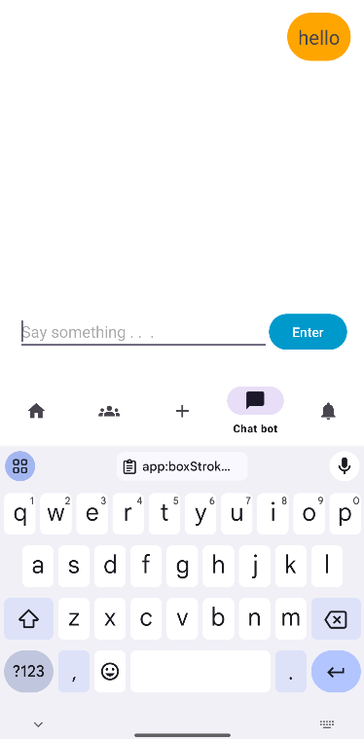
ACTIVITIES
Write messages
Click “Enter” to send the messages.
Activities
Demo
Conclusion
7

Slide 16
ACTIVITIES
Activities
Check notifications from friends and communities
Demo
Conclusion
7

Slide 17
DEMO
Demo
Conclusion

Slide 18
CONCLUSION
Creating a social news app - a challenging but rewarding experience.
Through features - posts, comments, voting systems, and user profiles, the app fosters community engagement and dynamic discussions.
The app has the potential to evolve with enhanced features.
Conclusion

Slide 19

THANKS FOR
LISTENING

